Slide 1
Health & wellbeing @trinity
Parent / Carer event
Wed Feb 19th 2020

Slide 2
Healthy Mind
Healthy Body
Healthy Respect

Slide 3
Two aspects to consider

Slide 4
Experiences and Outcomes from Curriculum for Excellence
Mental, Emotional, Social and Physical wellbeing
Planning for choices and changes
Physical Education, physical activity and sport
Substance misuse
Food and Health
Relationships, Sexual Health and Parenthood
Keeping safe – within Substance misuse and RSHP
Progression pathways from early to second level

Slide 5

A national teaching and learning resource for Relationships, Sexual Health and Parenthood (RSHP) education
https://rshp.scot
Notes:
These slides can be edited and adapted to suit your setting.

Slide 6

What is the resource?
A teacher or early years practitioner can use the resource to support teaching and learning.
All content is age and stage appropriate for learners 3-18 years, organised by Curriculum for Excellence Levels, from Early Level through to Senior Phase.
It can be used in formal and informal learning settings.
Content is up-to-date and engaging and meets the needs of learners with additional support needs, including mild to moderate learning disabilities.
Notes:
Parents may need some information and understanding about CfE Levels – and so what Level their child’s class or their individual child is learning at. In subsequent slides your setting can focus on what is most relevant to your audience. You may want to add or give this information also: The resource supports teachers to deliver the RSHP curriculum as expressed through Health and Wellbeing/RSHP Experiences and Outcomes and associated Benchmarks.

Slide 7
Why has it been developed?
There is a need to improve the quality, relevance, consistency and coverage of RSHP education.
We need to deliver RSHP education that helps protect children and young people from harm and supports them to understand that friendships and personal relationships should be healthy, happy and safe.
The resource helps teachers to source material that is age and stage appropriate, so that they can focus on building relationships with learners.
We need our RSHP education to reflect a modern and inclusive Scotland where we value and respect the human rights of everyone.
Notes:
Learners have identified inconsistencies and gaps in the delivery and quality of RSHP education in numerous consultation and engagement exercises, research studies and evaluations. The RSHP resource was developed as a result of identified need for RSHP education to be fully modernised, a recommendation of the Scottish Parliament’s Education and Skills Committee in their report ‘Let’s Talk about Personal and Social Education’.

Slide 8
Is the RSHP resource age and stage appropriate?
https://vimeo.com/361994410
Notes:
Having made the statement that the resource content is age and stage appropriate, this film addresses this, acknowledging it is a key issue for parents/carers. Duration 1 minute 56 seconds.
The slides that follow look at the content at each Level. Use those slides that are relevant to your parents/carers.

Slide 9
Early Level
Families and friendships, children learn:
That all our families are different, and that people who are important to the children provide care and love.
How to make and keep friendships, thinking about how they get along with other children, play together, co-operate and share. This can include learning about personal space and to recognise and respect how another person is feeling.
About the importance of kindness and showing kindness to others.
Every child being unique and special children learn:
That people are individual and unique.
About the similarities and differences among children in their group.
To understand that treating someone badly based on a difference is not okay.

Slide 10
Early Level
Their bodies, children learn about:
Names for parts of their body – and that parts of their body are private.
Keeping clean and why this is important – learning about hand washing and brushing teeth
Feelings and making choices children learn:
To recognise and express their feelings, including when they might feel safe or unsafe, happy or worried.
To identify adults that they can go to if they have a question or a worry, introducing the idea of trust.
Looking after them and other living things children learn about:
Where living things come from.
The needs of plants, animals and babies.
That there are professional people who help and care for them
Information for parents and carers about RSHP learning at Early Level at school and at home: https://rshp.scot/early-level/
Notes:
In terms of the correct names for parts of the body you may want to check out the question in our FAQ section https://rshp.scot/faq/ that reads: Why do children learn to use the correct words for parts of their body?

Slide 11
First Level
Relationships children learn about:
What makes then unique
Families, and how all our families are different
The different adults who might care for children – like teachers, support staff in school
Making and having friends
Being a boy and a girl and that they can be any kind of boy or girl they want to be
What makes people alike and what makes us different (diversity)
Respect for others and the importance of being kind.
Growing up and their body children learn about:
Making choices and decisions
Looking after their body and keeping clean
How their bodies change as they grow
Names of parts of their body and names for private body parts; we use the words penis, vulva, bottom, nipples
Parts of their body are private
Other people should not touch the private parts of their body
What behaviour is okay in public and what is okay in private (for example pulling pants up before leaving the bathroom).
Notes:
In terms of the correct names for parts of the body you may want to check out the question in our FAQ section https://rshp.scot/faq/ that reads: Why do children learn to use the correct words for parts of their body?

Slide 12
First Level
How human life begins, pregnancy and birth children learn about:
The life cycles of plants and animals
How a baby is made (conception)
Pregnancy and how a baby is born
What a baby needs and how to care for a baby.
Information for parents and carers about RSHP learning at First Level at school and at home: https://rshp.scot/first-level/

Slide 13
Second Level
Relationships children learn about:
What makes them unique and what makes people alike and what makes us different (diversity)
Making and having friends
Being a boy and a girl, and that they can be any kind of boy or girl they want to be
Loving relationships and being attracted to others
Respect for others and the importance of being kind – in our face-to-face relationships and online.
Being safe children learn about:
Social media and being safe and smart online
Feeling safe and unsafe
Different kinds of abuse and neglect that can happen to a child
What we mean by consent
Who they can go to for help and support.
Notes:
In terms of some aspects of the learning that is introduced at Second Level you may want to check out the questions and answers in our FAQ section https://rshp.scot/faq/ that read: Why does the RSHP resource have learning about abuse in the primary school years? How is this done? And also Why and how does the RSHP resource help children and young people to learn about sex and gender equality? And also: Why and how does the RSHP resource help children and young people to learn about consent?

Slide 14
Second Level
Growing up and learning about their body children learn about:
Making choices and decisions
Looking after their body and keeping clean
Puberty and how the bodies and emotions of both girls and boys change as they grow
What ‘having sex’ is and about contraception and condoms.
Conception, pregnancy, birth and being a parent/carer children learn about:
How a baby is made (conception)
Pregnancy and how a baby is born
Being a parent and thinking about what kind of parent they would be.
Information for parents and carers about RSHP learning at Second Level at school and at home: https://rshp.scot/second-level/
Notes:
In terms of some aspects of the learning that is introduced at Second Level you may want to check out the questions and answers in our FAQ section https://rshp.scot/faq/ that read: Why does the RSHP resource have learning about ‘having sex’ in the primary school years? How is this done?

Slide 15
Parents and Carers
Across this resource, and in our school approach to RSHP education, there is an acknowledgement that parents and carers are the primary educators of their children.
By learning together at home and school we can help consolidate learning – it’s a partnership approach.
Notes:
A few final points that might be useful to reiterate. It is helpful that parents/carers understand what is being delivered in school so they can support this at home and consolidate the learning. Also to feel involved in such a vital area of their child’s learning. The vast majority of parents and carers want their child to receive RSHP education from schools and find it useful to know in advance what will be taught, what language or terminology is being used and what additional reading they can do to complement their child’s learning. This is one of the main reasons for the RSHP website being open access.
Connecting with home – the RSHP resource offers text throughout so that educators can communicate about blocks of learning and even individual lessons. There are suggestions as to how the learner can take what they have been learning home. There are also book recommendations to be shared with home, and at each CfE Level there is suggested text for information that can go home that talks about RSHP learning in the home and at school. The 2 short films that follow address age and stage appropriateness and then the importance of parents/carers.

Slide 16
If you have further questions about the RSHP resource the FAQ section on the site may be of help: https://rshp.scot/faq/
However, please do not hesitate to contact school if you have any concerns or questions.
https://rshp.scot/
Notes:
To end, the FAQ section on the resource gives more detailed responses to those most asked questions.

Slide 17
FAQs
Q: Can I opt out of parts of the programme?
A: Yes but we encourage parents / carers to allow their children to be part of all of the programme. Discussion needs to take place as to what specific parts of the curriculum a child is not to be taught
Q: Will my child hear about this from other children?
A: Yes. We always ask children to respect the wishes of families who have opted out and to treat this with understanding. However, invariably, children ask questions of each other.

Slide 18
Q: What happens if a child is upset or anxious?
A: We are trained to manage children’s anxiety in a supportive way. We would let you know so that you could also support at home.
Q: What if I am worried as a parent about the impact on my child or about sensitive family information such as adoption, assisted conception etc?
A: If you feel comfortable, please let us know about any issues that you feel might arise. We will always treat this information confidentially and will not share information without your prior permission except for reasons of child protection.

Slide 19
Questions / comments

Slide 20
Mental health & emotional wellbeing

Slide 21
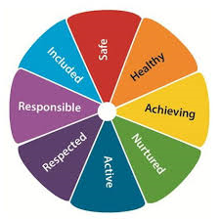
SHANARRI wheel
S – safe
H – healthy
A – achieving
N – nurtured
A – active
R – respected
R – responsible
I - included

Slide 22
Being well, staying well
Keep connected
Do something you are good at
Respect yourself
Stay healthy
Have fun
Become a problem solver
Ask for help
Belong to a group
Be kind to others
Make a difference

Slide 23
Achievement board
Four contexts planning
Pay what you can
Supported lunch/break activities
Nurture space
Learning Powers
Building resilience
Mentoring
Outdoor learning
Seasons for Growth
Couch to Club
Poverty proofing
Performances
Trinity Mile
Park It
Buddies
Partnership working
Trinity Together
1:1 dialogue with learners
ACES awareness
Attainment discussions
Community groups
Growth Mindset
Trinity Talks
GIRFEC
Transition programme
Family support worker

Slide 24
Bikeability
Walk to school
Fallen out and made up
Fruit bowls
Mindfulness and yoga
Asked for help
Online safety
Teaching others
Chickens
Playground tidy
Benmore
Tree climbing
Vegan cafe
Presentations
Written letters
Fairtrade
Red Nose Day
Marathon running
Seven hills challenge
Swimming
Sustainability
Vegetable growing
Trinity Talks
International visitors
Art day
School partnership

Slide 25
Suggestions?

Slide 26
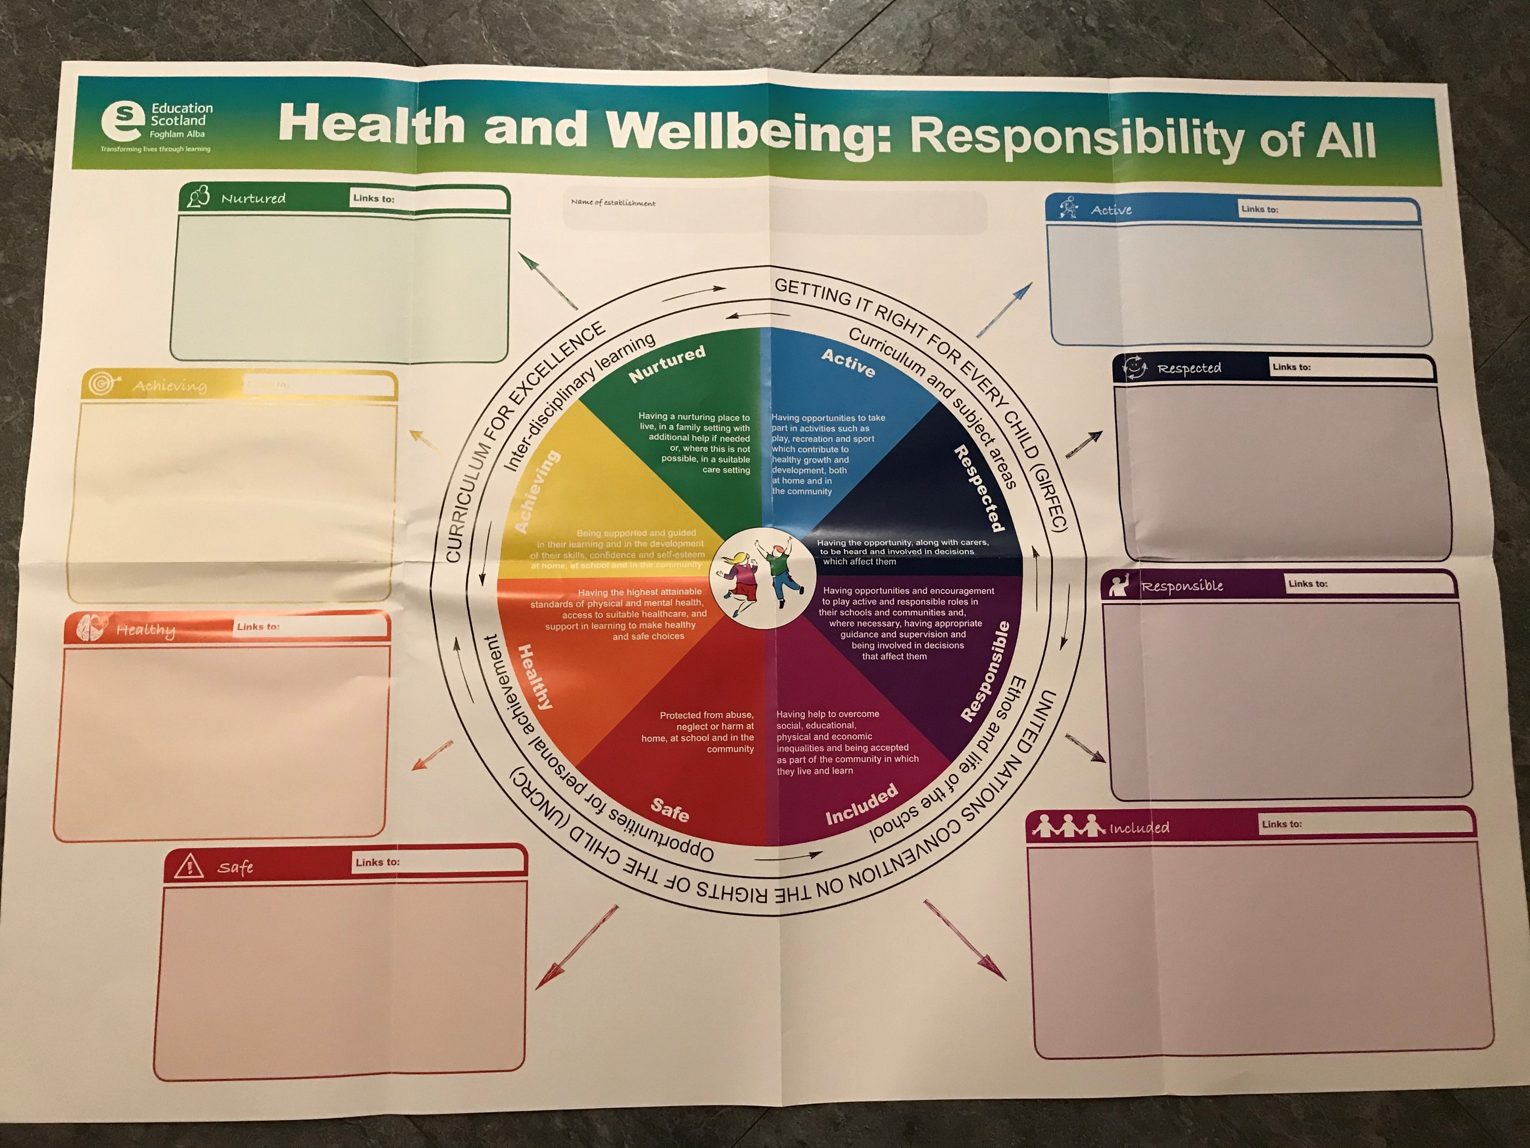

Slide 27
Mental health & emotional wellbeing
Top Tips for Parents and Carers (and school staff)

Slide 28
Pupil voice
Gathered in consultation with over 450 children and young people.
What do you hope your parents and carers will do to help you develop good mental health and emotional wellbeing?

Slide 29
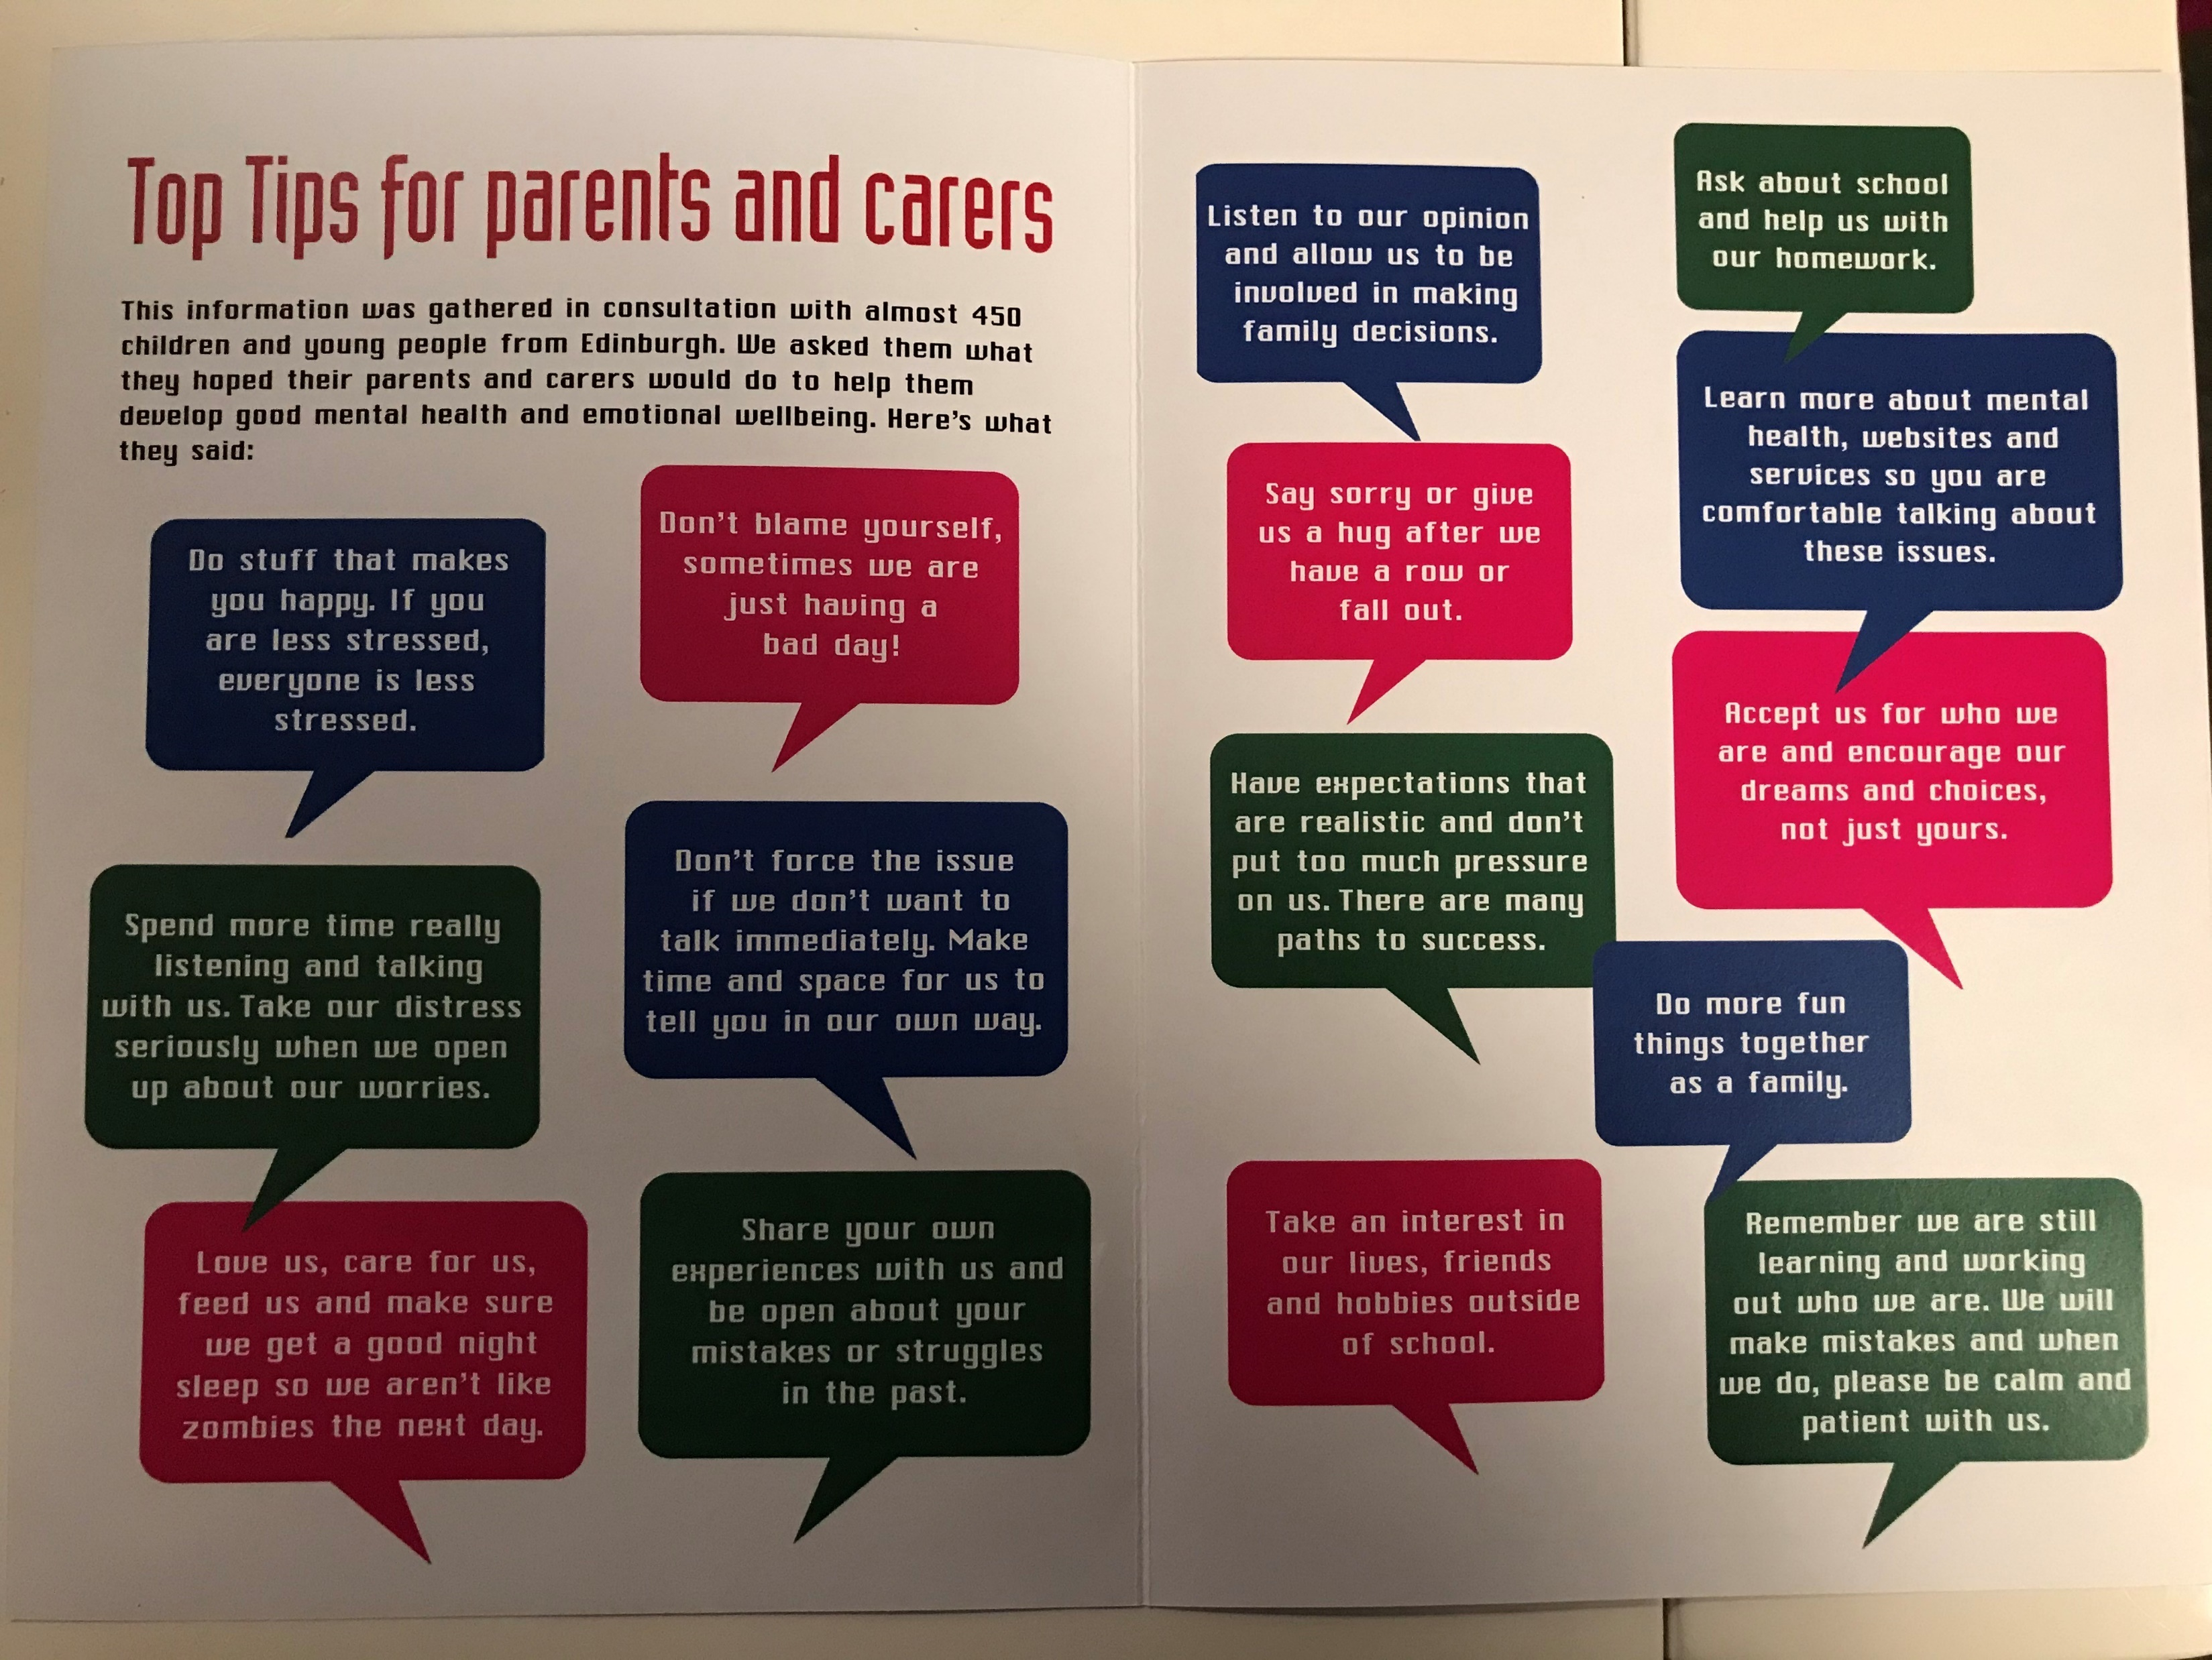

Slide 30
Questions / comments

Slide 31
Thank you

